Slide 1
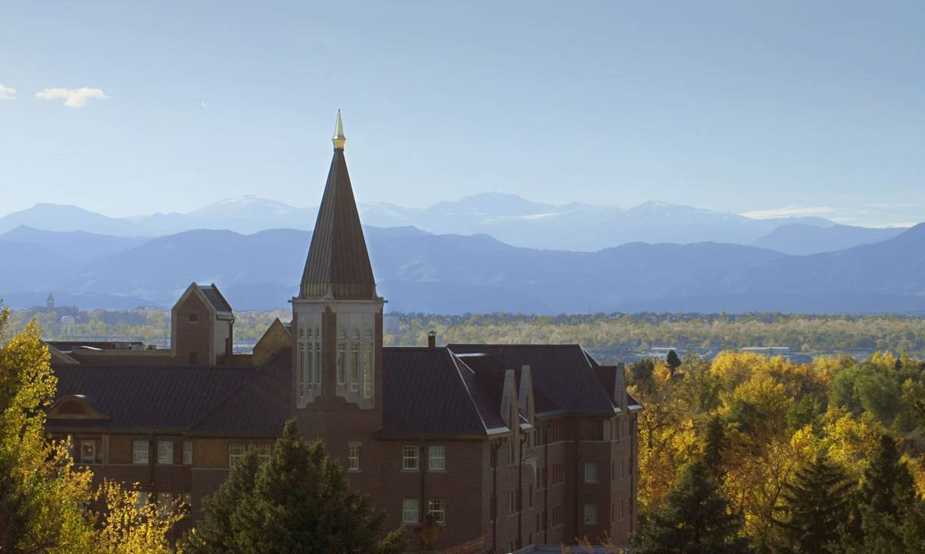

Billing and Financial Aid
Kathy Shoemaker
Bursar
Chris George
Director of Financial Aid

Slide 2
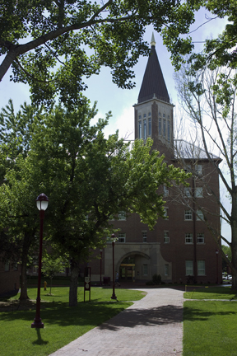
Agenda
The role of the Bursar and Financial Aid offices
Student Billing, Payments, & Refunds
Health insurance waivers
Funding Options
Special Circumstances
Communications

Slide 3
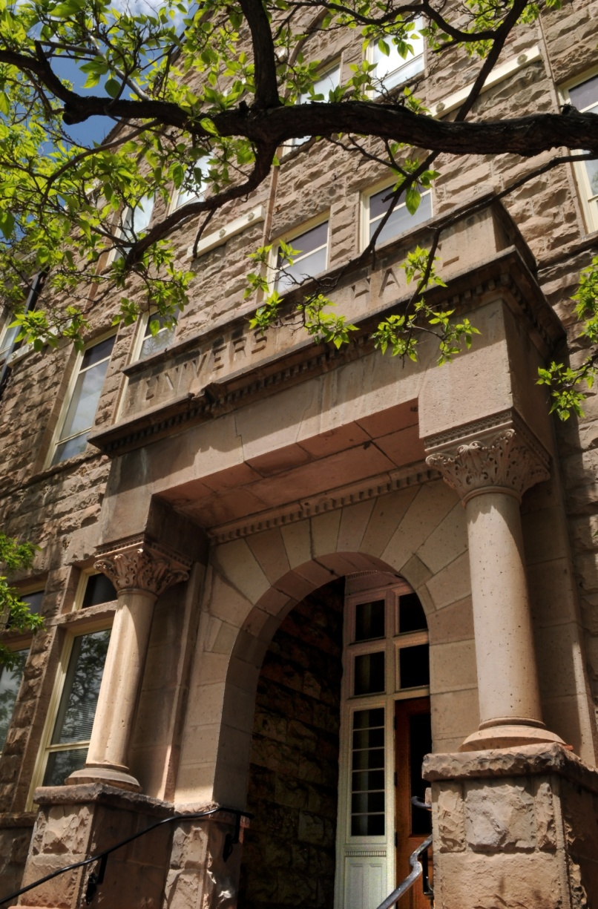
Roles
Bursar’s Office
Student Billing
Payment Plans
Perkins Loans
Health Insurance Waiver
Financial Aid Office
Process Aid Applications
Award Scholarships, Grants, Loans, Work Study
Send Award Letter
Academic Units
Assist in the selection of departmental scholarships

Slide 4
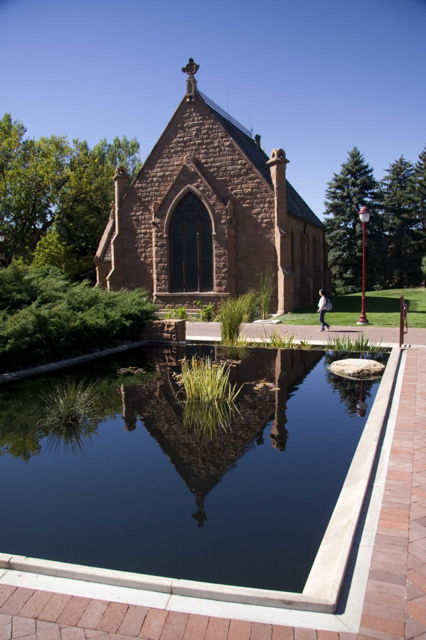
Billing
The University of Denver is paperless
ecoBills are sent to the student’s preferred email address
  An additional email address may be designated to receive the ecoBill
  Password protected
  Default password consists of the last 4 digits of your students DU ID# and all four digits of their birth year
  Password can be changed
Changes to ecoBill setup are done through webCentral

Slide 5
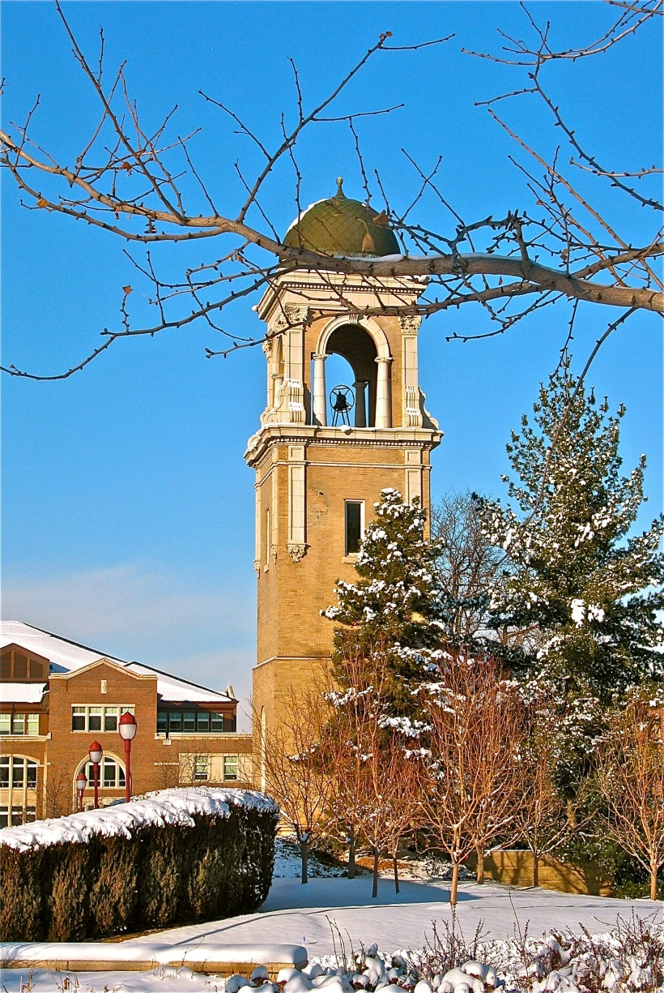
Billing – New Students
ecoBills are generated after registration
  Emails are sent Sept. 7th
  Bill is due Sept. 28th
ecoBills are emailed approximately 4 weeks prior to the beginning of each term
  Also available to view on webCentral

Slide 6
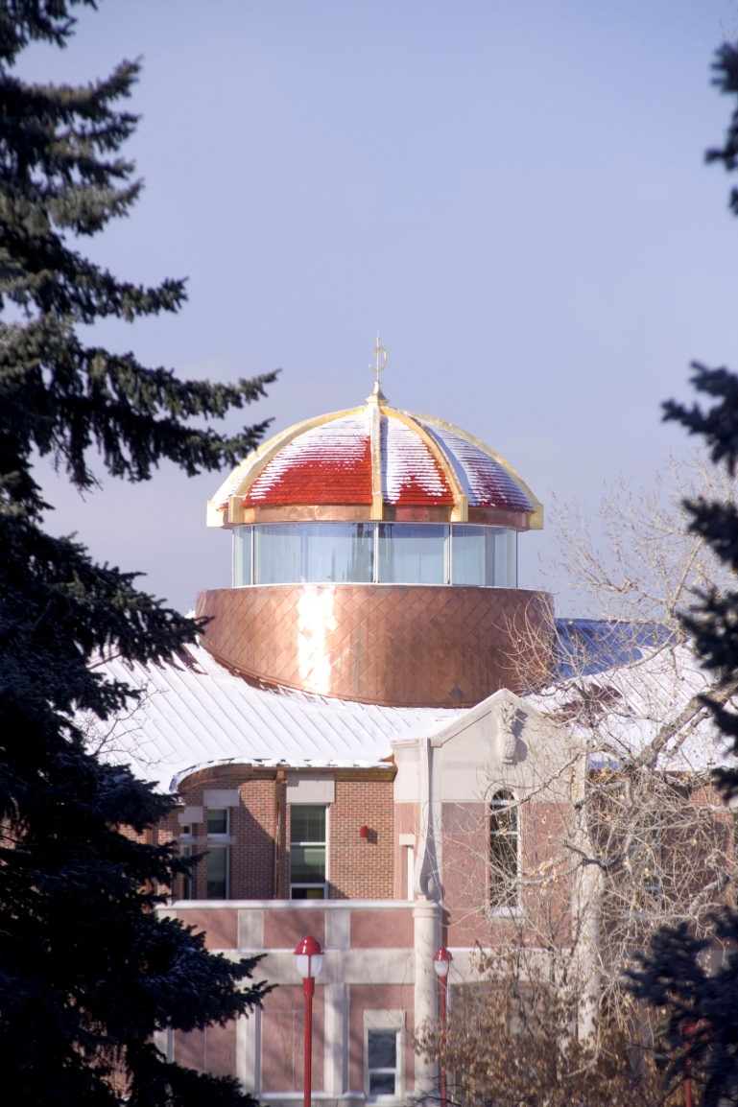
ecoBill
Sign into webCentral
Select the Student tab
Locate the My Statement section in the center of the page
Select ecoBill Account Management
Follow the instructions to select new password or adding an email address
Once complete, submit to save changes
www.du.edu/bursar/ecobill.html

Slide 7
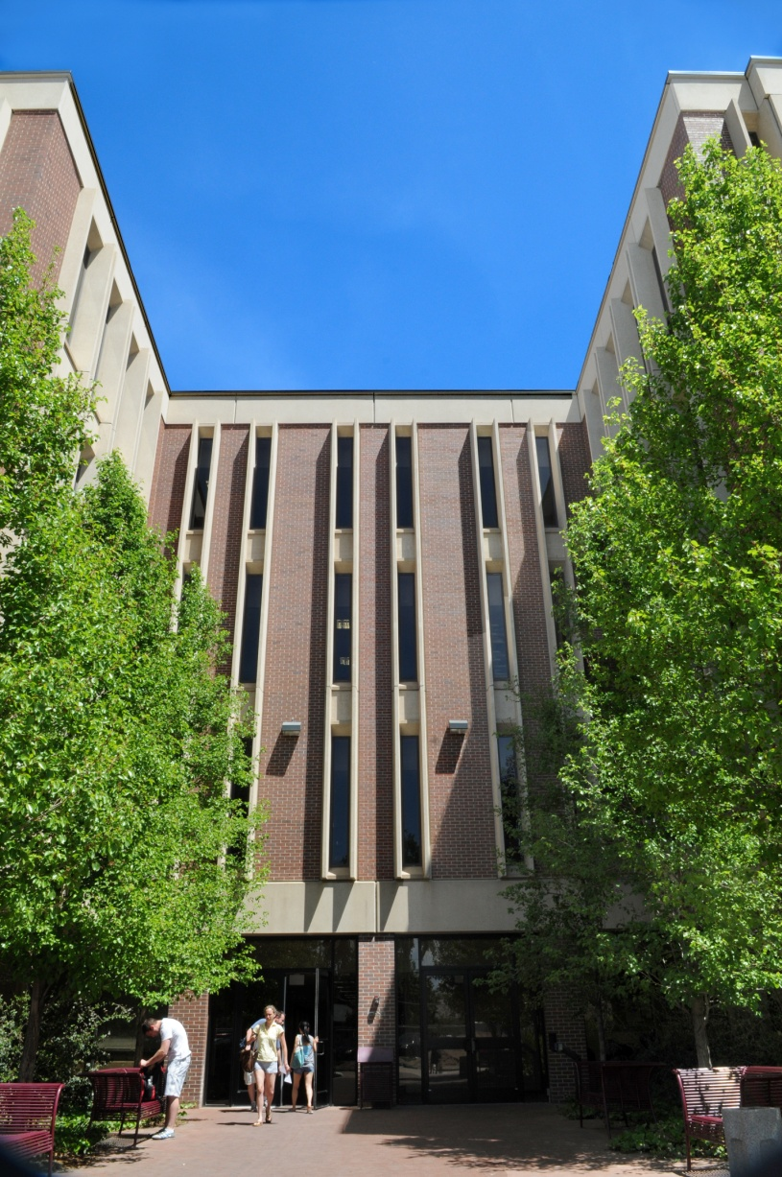
ecoBill
What is included?
Tuition
Technology Fee
Activity Fee
Room & Board Charges
Parking Charges
Health Insurance
Health & Counseling Fee
Disbursed or anticipated financial aid
Payments

Slide 8
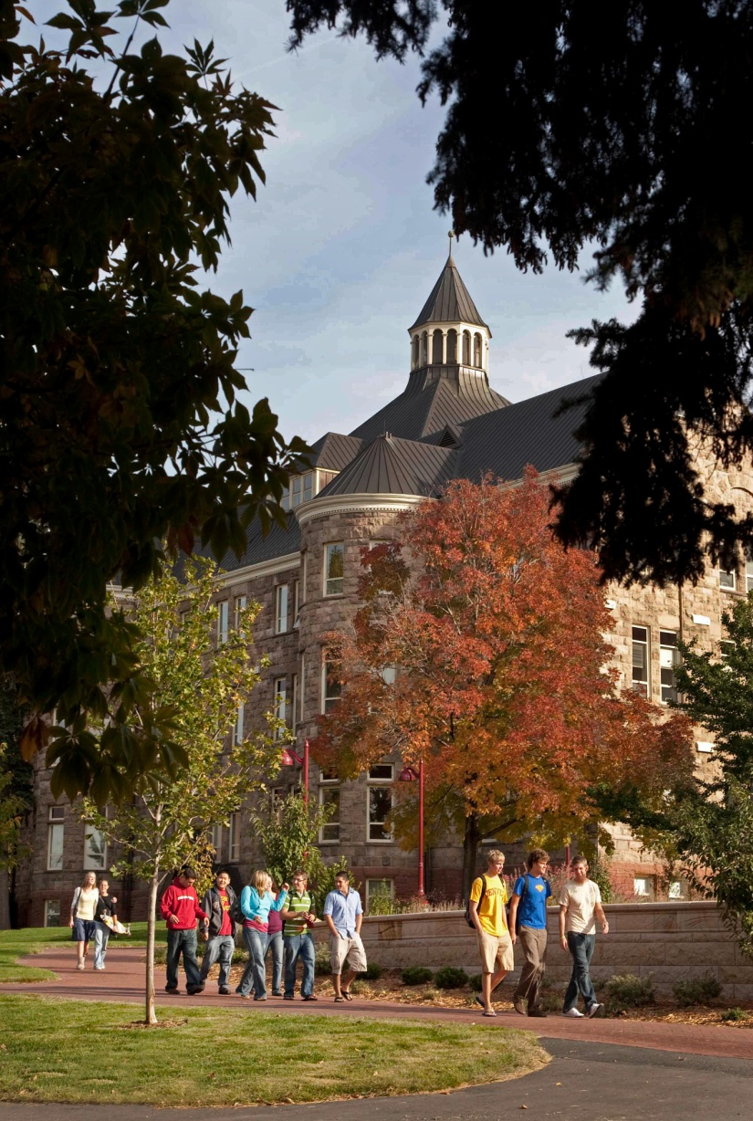
Disbursement
Financial Aid pays directly to the student’s bill 10 days prior to the start of term
  Must be registered with no outstanding financial aid requirements
  Full-time status is often required (12 credit hours)
  Federal Direct loans have an origination fee that we are required to collect at disbursement

Slide 9
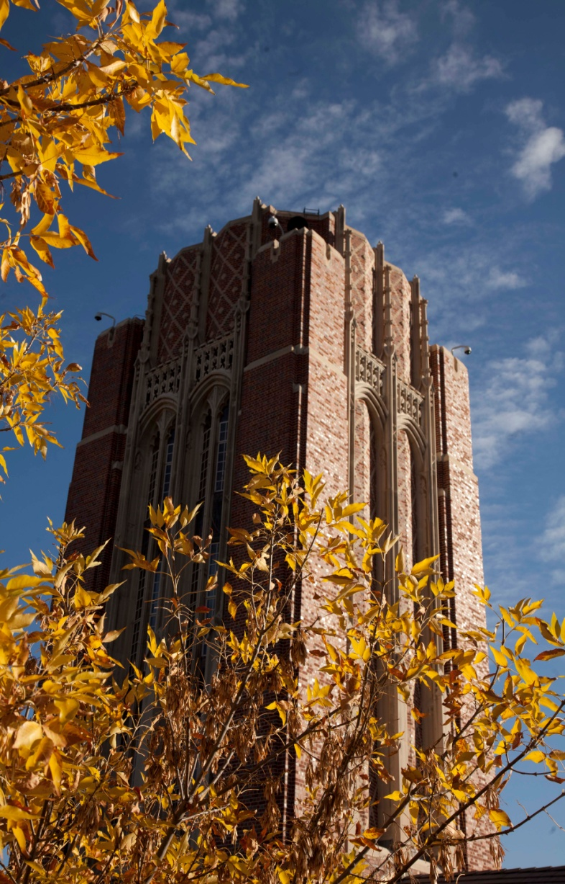
Payments
Payment is due ten days prior to the start of the term
  Fall - September 28th
  Winter – December 28th
  Spring – March 15th
Late fees of 1.5%, minimum of $150 may be assessed to accounts which are not paid in full by the due date
Additional late payment fees are assessed monthly until account is paid in full

Slide 10
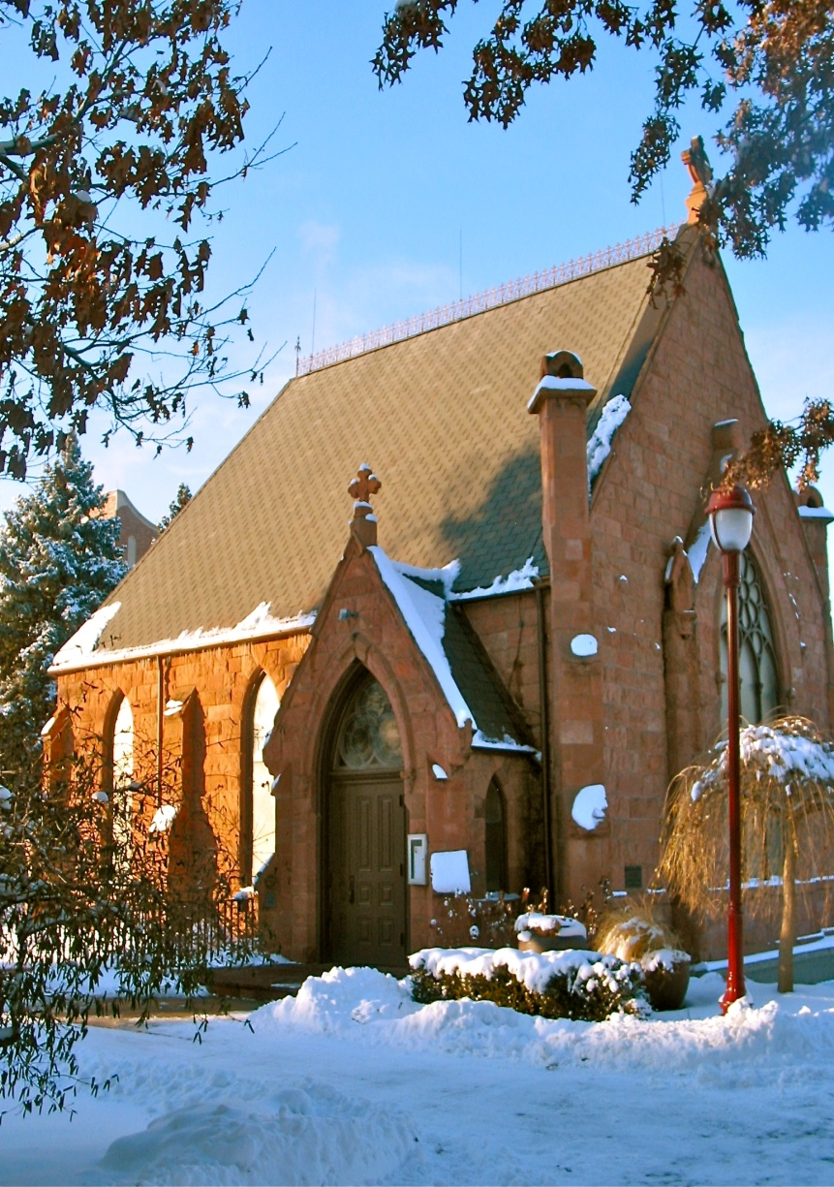
Payments
Accepted at Cashier’s Office (1st floor of University Hall)
  Cash
  Personal Check
  Money Orders
  Cashier’s Checks
Electronic Payments
  ACH Payments through Online Payment link
  Wire Transfer
Options available on the Bursar’s website

Slide 11

Payment Plans
Full Year (9 payments)
  August - April
2-Term (6 payments)
  Aug-Jan, Nov-Apr
1-Term (3 payments)
  Aug-Oct, Nov-Jan, Feb-Apr
  Summer: May-July
$50 enrollment fee
Payment due the first of the month
Consider the 6 month payment November - April

Slide 12
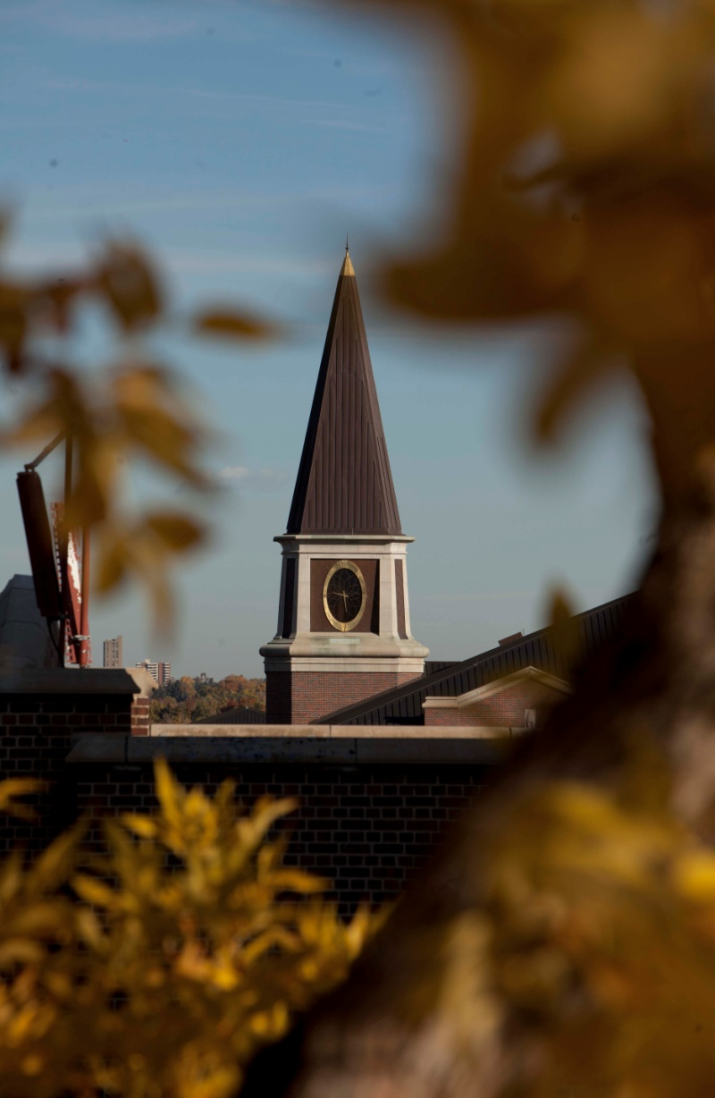
Refunds
Refund: Financial aid in excess of charges on student bill
Issued 2 business days after the disbursement of financial aid
  Fall – September 11
  Winter – January 1
  Spring – March 19
Refunds due to adjustments of tuition related charges are run nightly after initial disbursement

Slide 13
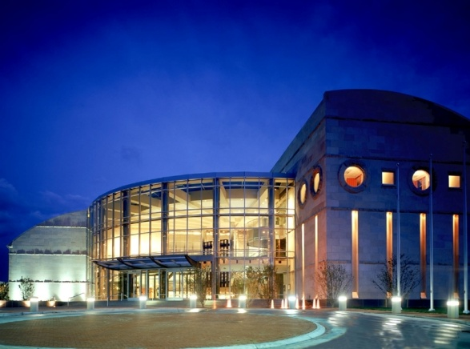
Additional Funding Options
Parent PLUS Loans
  Federal loans available to credit worthy parents of undergraduate students
  Repayment of principle and interest begins 60 days after disbursement, can be postponed
  7.9% fixed interest rate
Private student loans
  Credit-based consumer loan to pay for educational expenses
  Terms and interest rates vary
  Payments may be postponed

Slide 14

Scholarships
NEW Scholarship Search section on the Financial Aid website
  Now would be the time to start looking for next year
  Organizations that send information directly to our office
  Departmental scholarships that require applications (available in January)
  Private scholarships search engines
    CollegeinColorado.org
    Fastweb.com
    Scholarships.com

Slide 15
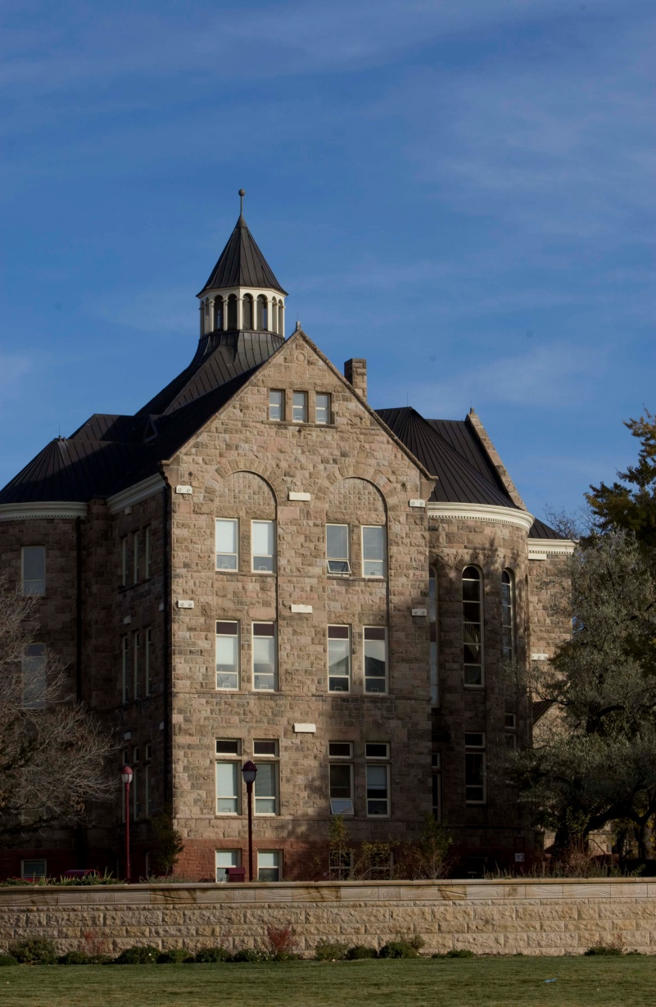
Private Scholarships
Private scholarship reduce the financial need of the student
  Adjustments to financial aid may need to occur in some instances
  How we reduce funding if required
    Loans
    Work Study
    DU Educational Grant
Where to send private scholarship checks?
  Include student name and ID
  Office of Financial Aid
  University of Denver
  2197 S. University Blvd.
  Denver, CO 80208-9403

Slide 16
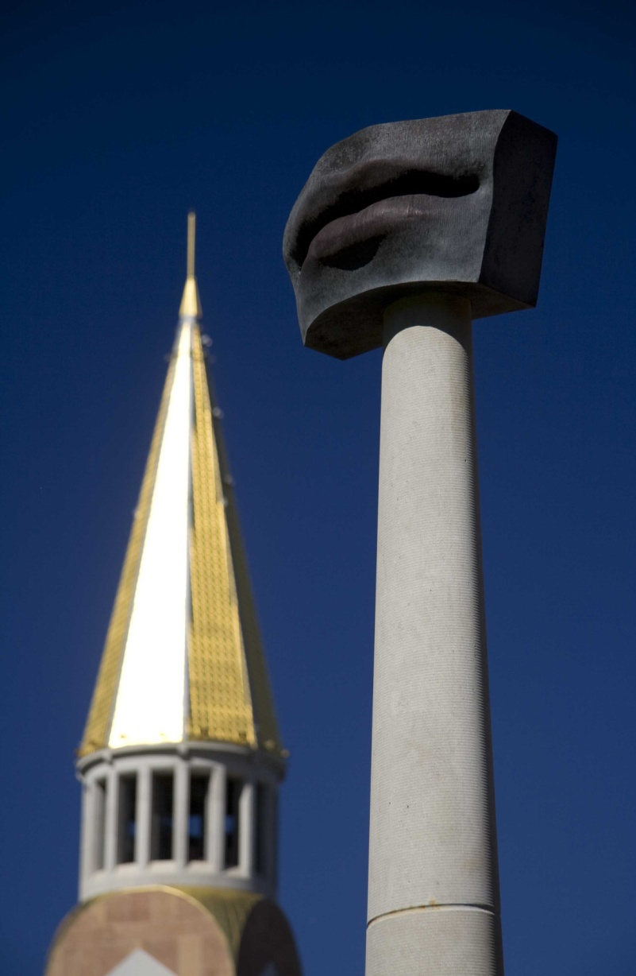
Work Study
Decreasing funding from both state and federal government
  University is making up a portion of the loss with its own funding
  Funding isn’t available to all students who qualify
Student Employment (within the Office of Financial Aid)
  Work Study hiring fair on Saturday
  Jobs posted online
  Students get to seek out jobs, rather than assigned locations
Student are paid bi-weekly through payroll, not the student account

Slide 17
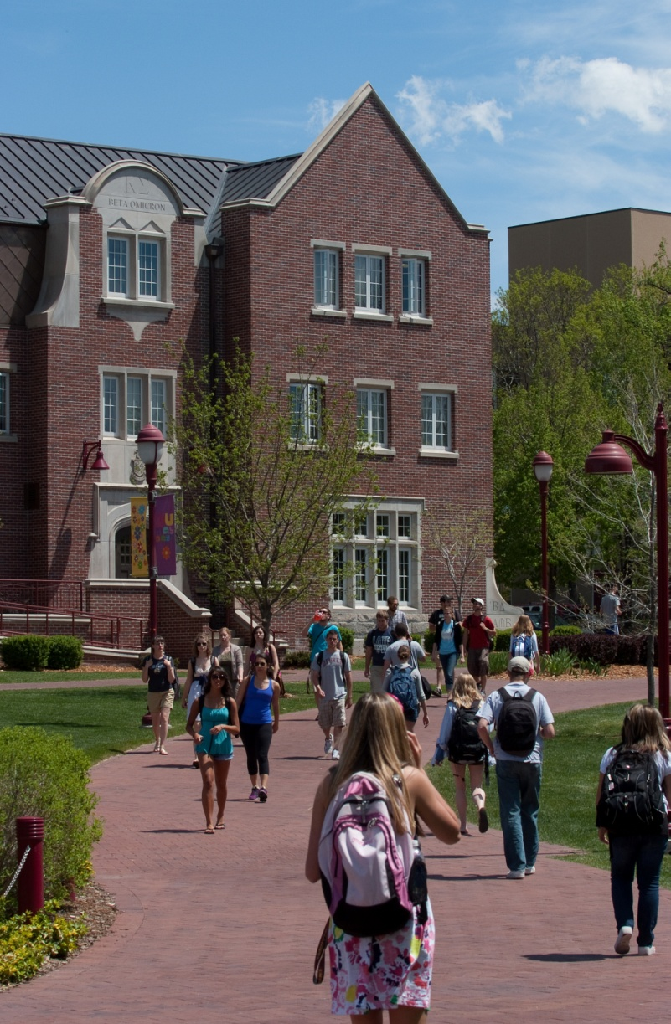
Non-Work Study Opportunities
Over 100 opportunities on the Student Employment website (www.du.edu/studentemployment)
Sodexho (Dining Services)
  Cashiers, Baristas, Catering Staff, etc
DU Call Center (fundraising)
Nannies/Babysitting
Medical receptionist
Sales assistant for an online outdoor recreational equipment business,
Hostess and wait staff at restaurants
Fitness instructors

Slide 18
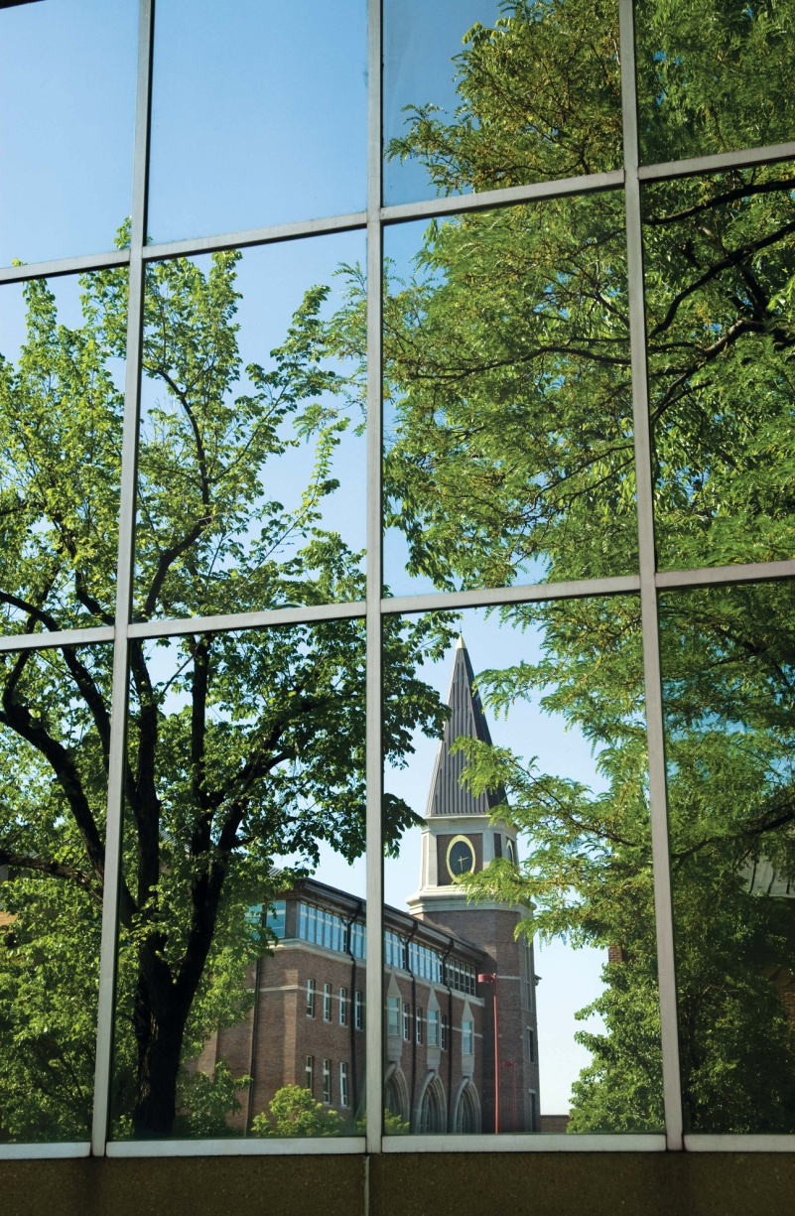
Special Circumstances
We understand that special circumstances occur that may impact a student’s financial aid eligibility.
Examples of “Special Circumstances”
  Loss of employment or reduction in wages
  Excessive medical or dental expenses not covered by insurance
  Bankruptcy or foreclosure
  Divorce or separation of parents
  Loss of child support
Contact an advisor in Financial Aid

Slide 19

Financial Aid Eligibility
Enrolled in 12 credits hours for most financial aid to pay
Maintain a 2.0 cumulative GPA (2.5 for accounting majors)
Complete and pass a minimum of 80% of all courses attempted
Additional requirements exist for gift, endowed, and private scholarships. They vary by department or donor

Slide 20

Looking ahead
Apply for financial aid annually
  CSS PROFILE available in October 1st, 2012
  FAFSA available on January 1st, 2013
March 15, 2013 is the priority deadline for returning students.
Requests for additional documentation are emailed directly to the student and available on webCentral
Financial aid awards for continuing students are emailed at the end of May

Slide 21
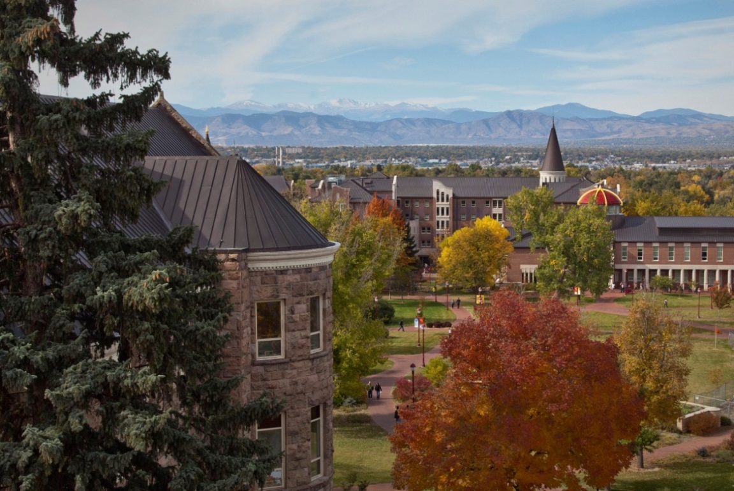
Questions?
Office Hours: 8 am to 4:30 pm
Bursar’s Office
2197 S. University Blvd
Denver, CO 80208
303-871-4944 bursar@du.edu
Office of Financial Aid
2197 S. University Blvd
Denver, CO 80208-9403
303-871-4020 finaid@du.edu
Notes:
Monday Office Hours: Bursar 11:30am to 2pm, Financial Aid 11am to 3pm
Health & Counseling Presentation: 10am and 11am Tuesday

