Slide 1
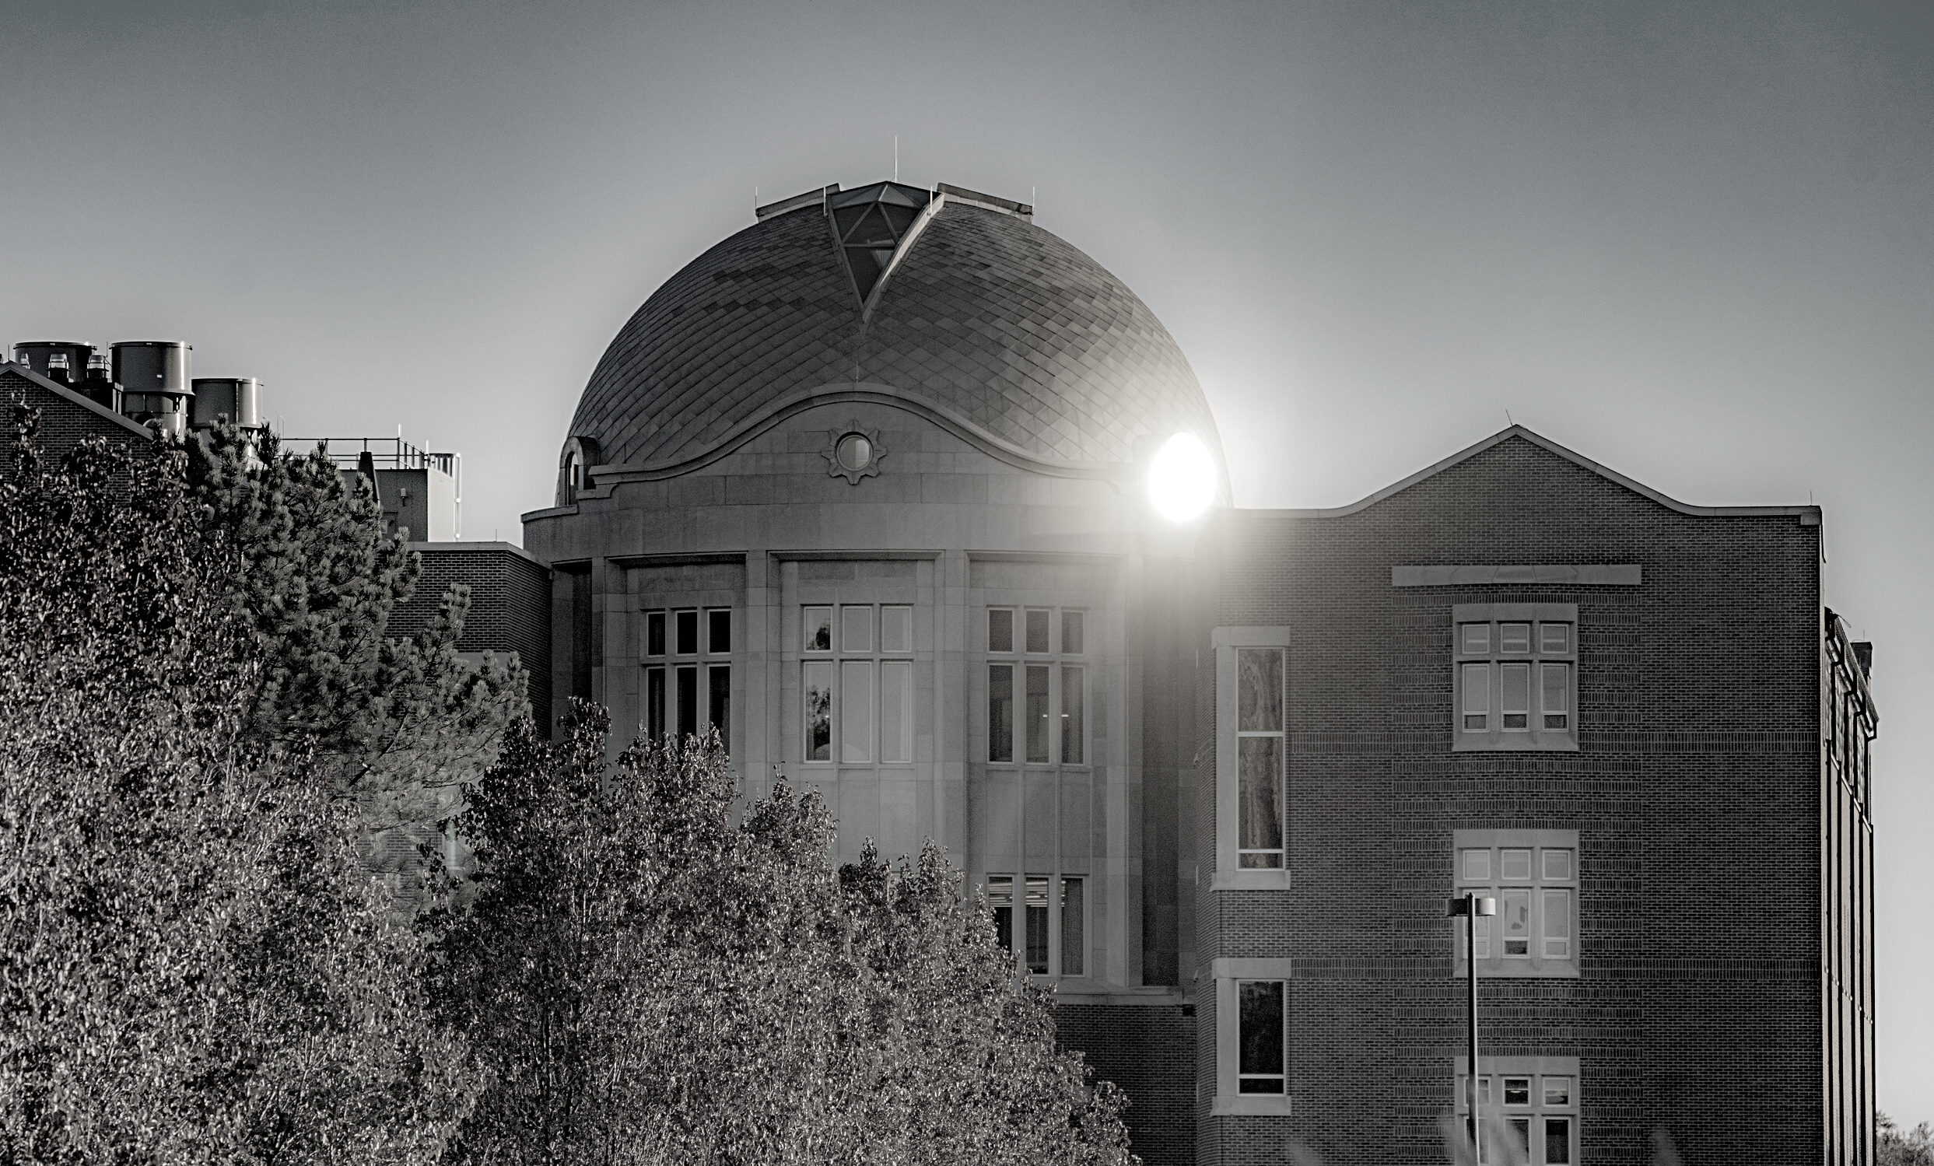
First Quarter Advising
Notes:
Hello! My name is April Osborne and I am an Academic Advisor in the Office of Academic Advising here at DU. I am here today to chat with you about what to expect for your first fall quarter registration if you are a Computer Science or Engineering major in the Daniel Felix Ritchie School of Engineering and Computer Science.

Slide 2
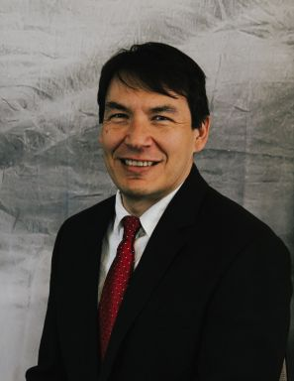
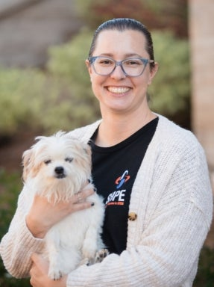
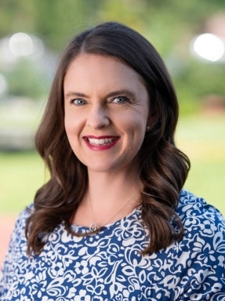
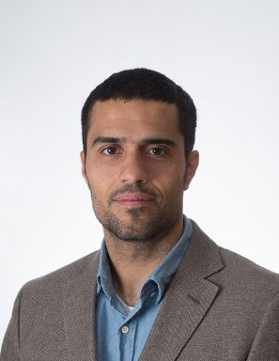
Important Departmental Contacts
Meredith Corley
Computer Science Advising Related Questions
meredith.corley@du.edu
Dr. Breigh Roszelle
Mechanical Engineering or Undeclared Engineering Advising Related Questions
breigh.roszelle@du.edu
Dr. Jason Roney
Assoc. Dean of Undergraduate Studies
jason.roney@du.edu
Dr. Goncalo Martins
Computer or Electrical Engineering Advising Related Questions
goncalo.martins@du.edu
Notes:
I first want to introduce you to some important folks in the Ritchie School of Engineering & Computer Science.
The Associate Dean of Undergraduate Studies in the College is Dr. Jason Roney.
For Computer Science advising related questions, please contact Meredith Corley
For Mechanical Engineering advising related questions, please contact Dr. Breigh Roszelle
For Electrical or Computer Engineering advising related questions, please contact Dr. Goncalo Martins.

Slide 3
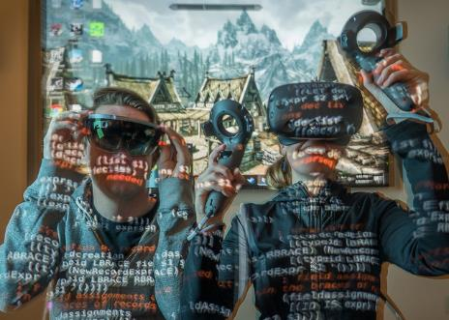
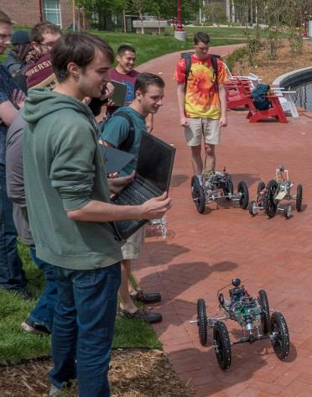
DEPARTMENTS AND DEGREES
Computer Science
Computer Science – BS, BA, minor
Game Development – BS, BA
Applied Computing – BA
Electrical and Computer Engineering
Electrical Engineering – BS, minor
Computer Engineering – BS, minor
Electrical Engineering with a Mechatronics Concentration – BS
Mechanical and Materials Engineering
Mechanical Engineering – BS, minor
Notes:
First is a quick overview of the Ritchie School’s departments and degrees. In our computer science department, we have three different majors, computer science, game development and Applied Computing. You'll notice that with computer science and game development, there is an option for a Bachelor of Science degree or a Bachelor of Arts degree. I will go through what the differences would be for your first-quarter registration depending on which of those you are interested in. Next, we have our Department of Electrical and Computer Engineering. We have a majors and each of those degrees as well as a degree in electrical engineering with a mechatronics concentration. And then lastly in our Department of Mechanical and materials engineering, we offer BS in mechanical engineering.

Slide 4
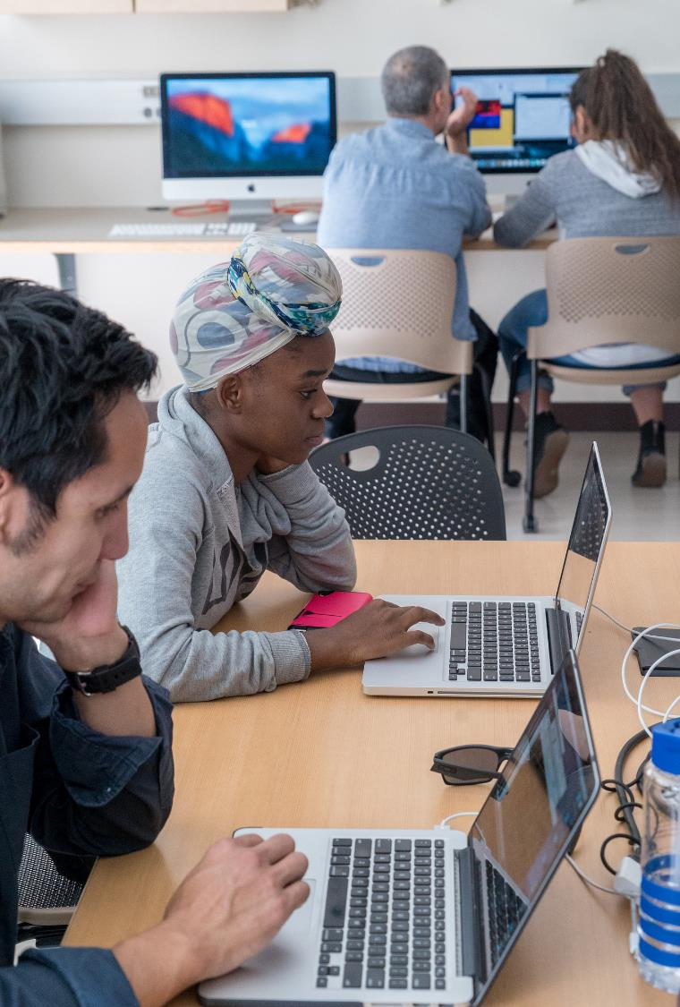
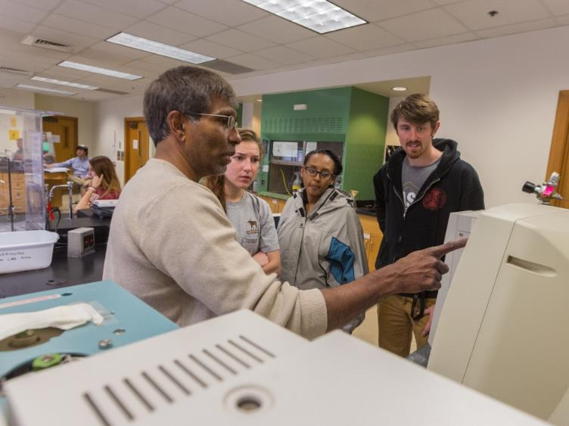
COMPUTER SCIENCE
Fall Quarter Coursework
FSEM 1111 – First Year Seminar (4 credits)
COMP 1201 - Introduction to Computer Science I (2 credits)
COMP 1351 - Introduction to Programming I (3 credits)
Common Curriculum or Language course (4 credits)
MATH 1951 – Calculus I (4 credits) (BS only*)
MATH 1941 – Calculus I Workshop (1 credit**)
Common Curriculum or Language course (4 credits) (BA only*, if not taking Calculus)
TOTAL – 17-18 Credits
*Only BS Computer Science or Game Development degrees require Calculus, the BA does not, and these students should take an additional common curriculum or Language course.
** MATH 1941 – Calculus I Workshop is not required but is recommended for students that need additional support developing calculus skills. Math Advising Document.
Notes:
I'm going to start with the first fall quarter coursework for computer science. Keep in mind that this would be the same, whether you are planning in majoring in computer science, game development, or applied computing. The slight difference I'll discuss is whether you're interested in the BA or the BS. All first-year students take the first-year seminar or FSEM course. In addition to this, computer science students will take two courses within the department. One is Introduction to Computer Science I, and the next is Introduction to Programming I. Additionally, we would suggest that all our computer science students take either one of their common curriculum courses or start their language sequence. Now, this is the difference between the BS and the BA Degrees. If you are interested in the Bachelor of Science degree, then you need to start taking the calculus sequence. You will start with calculus I, which is Math 1951. If you are absolutely sure you are not interested in the BS and are looking at the BA, then we would suggest you take another common curriculum course instead. We do just point out that if you believe you would have any interests in the BS, go ahead and register for MATH 1951.
If you are concerned about performing well in your required calculus courses, we HIGHLY encourage you to register for a calculus workshop alongside your calculus course.
The Associated workshop for Calculus I is MATH 1941. This is a 1 credit course taken concurrently with Calculus I. Students will work in groups on challenging problems from Calculus to gain deeper understanding of the covered material. This additional credit hour represents a relatively small commitment in terms of time that can yield significant benefits for students enrolled in a Calculus course. Students that register for and participate in a calculus workshop earn higher grades in their calculus course and have lower DFW rates (D’s, F’s and Withdrawals).
Click the link in the pdf slide deck to review the Math Advising Document for more detailed information. This document also provides guidance using prior coursework, standardized test scores, and self-assessed readiness.

Slide 5
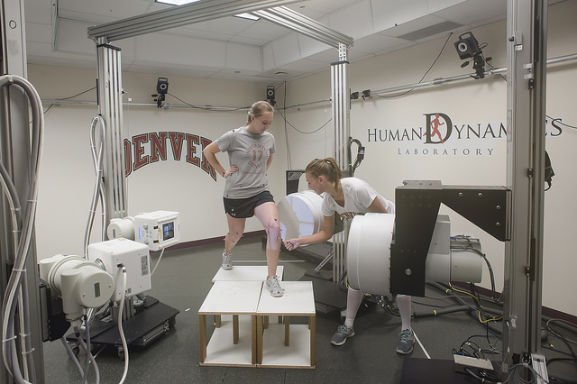
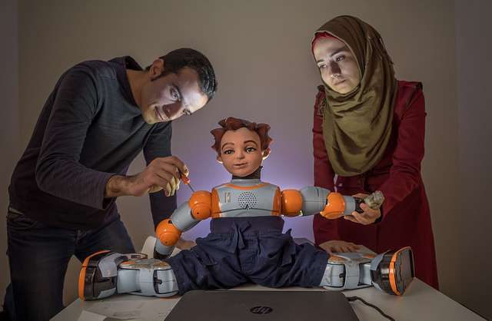
ENGINEERING (ALL MAJORS)
Fall Quarter Coursework
FSEM 1111 – First Year Seminar (4 credits)
CHEM 1010 – General Chemistry (3 credits)
CHEM 1240 – General Chemistry Lab (1 credit)
MATH 1951 – Calculus I (4 credits)
MATH 1941 – Calculus I Workshop (1 credit*)
ENGR 1611 – Introduction to Engineering Design (4 credits)
ENGR 1511 – Engineering Connections (1 credit)
TOTAL – 17-18 Credits
Note: Engineering majors are not required to take a language
*MATH 1941 – (Calculus I Workshop) Is not required but is recommended for students that need additional support developing calculus skills. Math Advising Document.
Notes:
For engineering students, which includes all engineering majors in the college – undeclared engineering, mechanical, electrical, and computer, are going to take the same fall quarter coursework. Unlike the computer science degree, there's no differences since these are all BS degrees. For your fall coursework, you of course, would still take your FSEM class. Next, you will take general chemistry with the lab. The lecture, which is CHEM 1010 and the lab which is Chem 1240. You must register for both. The registration system will not let you register for the lecture without the lab. Engineering majors will also start the calculus sequence, MATH 1951 and MATH 1941 Workshop, if desired. If you are concerned about performing well in your required calculus courses, we HIGHLY encourage you to register for a calculus workshop alongside your calculus course.
This is a 1 credit course taken concurrently with Calculus I. Students will work in groups on challenging problems from Calculus to gain deeper understanding of the covered material. This additional credit hour represents a relatively small commitment in terms of time that can yield significant benefits for students enrolled in a Calculus course. Students that register for and participate in a calculus workshop earn higher grades in their calculus course and have lower DFW rates (D’s, F’s and Withdrawals).
Click the link in the pdf slide deck to review the Math Advising Document for more detailed information. This document also provides guidance using prior coursework, standardized test scores, and self-assessed readiness.
Your last two courses will be engineering courses that you will start. One is Introduction to Engineering Design and the other is engineering connections. One thing to keep in mind for engineering students is that they are not required to take a language sequence.

Slide 6
FREQUENTLY ASKED QUESTIONS
What if I already have credit for Calculus 1?
We suggest taking Calculus II (MATH 1952) or a common curriculum course for the fall.
What if I already have credit for Calculus 1 but I would still take it?
Yes, you can take Calculus 1 again if you would like, however the credits will not be double counted.
What if I am not ready to take Calculus 1?
We highly encourage all first-year CS students interested in the BS and all engineering students to register for Calculus 1 fall quarter. We encourage you to take MATH 1941 (Calculus I Workshop) alongside MATH 1951. It provides students with additional structure and targeted support to enhance their learning experience in a calculus course. In a workshop meeting, students deepen their understanding of algebra and calculus concepts through collaborative problem-solving and receive personalized assistance from workshop leaders. The grade in the workshop is solely based on attendance and participation in the workshop; there is no homework and there are no quizzes or exams associated with the workshop.
Please review the Math Advising Document for additional guidance.
Notes:
Now that we've established the courses that our students typically take in the fall term, what happens if we need to do something different? So here are our answers to frequently asked questions students may have. The first is, what if I already have credit for calculus I ? In that case, for either computer science or engineering students, we would suggest that you take calculus II, which is the next course in the sequence, or a common curriculum course during the fall quarter. Please note that there are fewer sections of Calculus II offered in the fall term and more are offered in Winter quarter.
Next, some students may ask “I've taken calculus one or I have credit for it, but I would like to take it again.” You are welcome to do so. You can register for Math 1951 but just know that you cannot double count those credits. So for example, if you took an AP exam and got credit for MATH 1951, we can't double count those credits plus the credits of you taking it here at DU.
Some students also ask us what if I'm not ready to take calculus one, we do highly recommend all students who are engineering majors or students in CS that are interested in the Bachelor of Science degree, take Calc I first during the fall quarter. As I mentioned in previous slides, If you are uncertain of your readiness, please register for MATH 1941, the Calculus I workshop alongside MATH 1951 lecture. It provides students with additional structure and targeted support to enhance their learning experience in a calculus course. In a workshop meeting, students deepen their understanding of algebra and calculus concepts through collaborative problem-solving and receive personalized assistance from workshop leaders. The grade in the workshop is solely based on attendance and participation in the workshop; there is no homework and there are no quizzes or exams associated with the workshop.

Slide 7
FREQUENTLY ASKED QUESTIONS
What if I would like to explore another major in addition to computer science or engineering?
For CS, the only courses needed specifically for fall quarter are COMP 1201 and COMP 1351. The rest of your schedule is flexible to take courses from other departments, however we do highly encourage MATH 1951 if you are interested in a BS.
For engineering, If you would like to take a different course than those listed, Chemistry is the easiest to take later. In order to stay on track all others should be taken during fall quarter.
Notes:
Sometimes student ask ask us, what if I would like to explore another major in addition to computer science or engineering. For computer science, the specific courses that you will need for fall quarter are your FSEM, COMP 1201 and COMP 1351. The rest of your schedule is fairly flexible. So remember, for the computer science students that we recommended you add a common curriculum course. In place of the common curriculum class, you could take some introductory courses in another area of interest. Remember, if you are in computer science, and are pursuing the BS degree, we highly encourage the Calculus Icourse in the fall quarter. For engineering students, the easiest course to take later is general chemistry. But just know that you will have to take chemistry at some point, even if you would like to replace that with another exploratory course from another department.

Slide 8
FREQUENTLY ASKED QUESTIONS
What if I already have credit for another required course besides math?
If you already have credit for previous computer science experience, we suggest you next the next course in the COMP series or a common curriculum course.
If you are an engineering student and already have credit for chemistry, it is suggested you take a common curriculum course.
What if I feel 17-18 credits is too much?
We suggest to start with the 17-18 shown, however for engineering the easiest course to take at another date is General Chemistry. Do keep in mind this may require taking an extra course at a later date or over the summer to stay on track. For CS, the easiest course to take later would be a common curriclum course.
Notes:
Students often ask us, what if I already have credit for another course besides Math? If you already have previous computer science experience and you have credit for it, we would suggest the next course in that computer science intro to programming series, or a common curriculum course. If you're an engineering student and already have credit for something like chemistry, we would suggest that you fill that spot with an Additional common curriculum course, since it is also four credit hours so it matches well and those will be required at some point.
Lastly, some of our students will ask “What if I feel 17-18 credit hours feels too much?” We do suggest taking the 17-18 credit hours shown on the previous slides as this will keep you on track for both of these majors. That being said, for engineering, as I already mentioned, the easiest course to take later is general chemistry. So if you needed to reduce your course load, that would be an option. That being said, you will still be required to take that chemistry course later. Keep in mind that reducing credits now will increase credits that you're required to take later. For computer science, the easiest course to take later would be common curriculum Curriculum or language course.

Slide 9
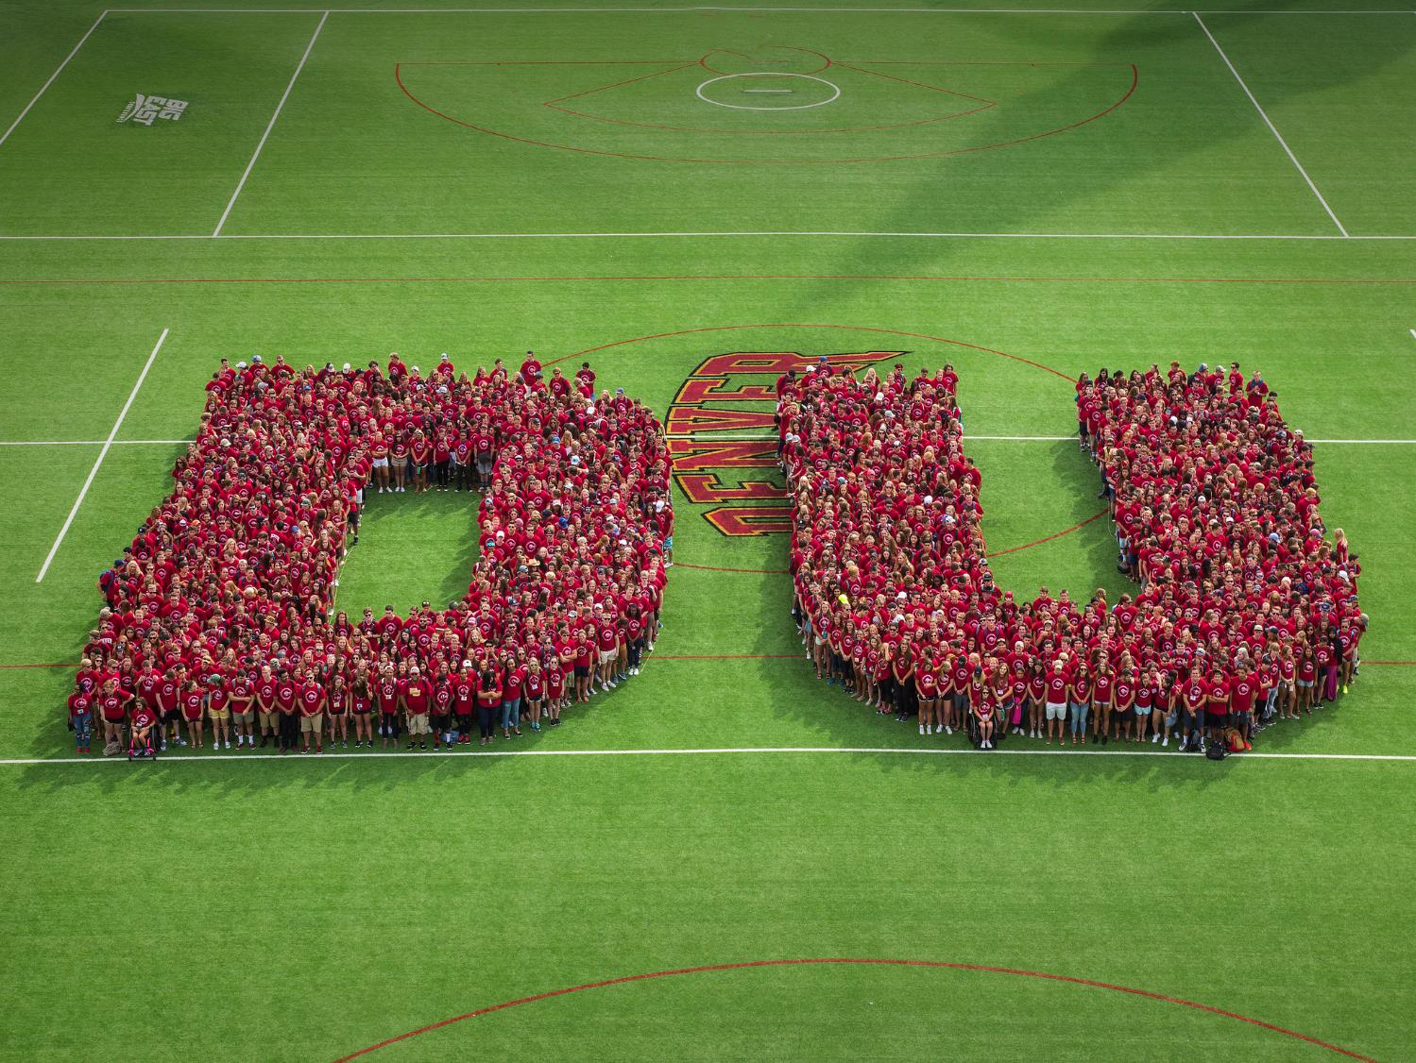
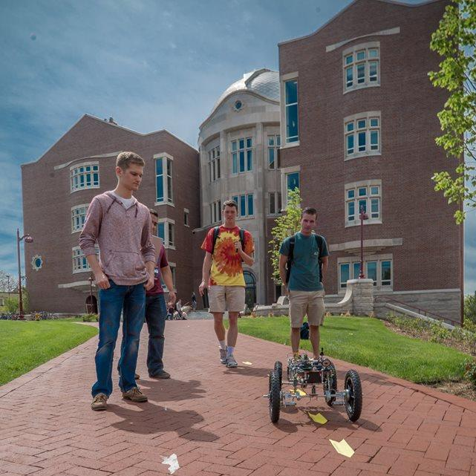
What if I have more specific questions?
Please contact the following people with specific questions about each major area:
Computer Science: Meredith Corley (meredith.corley@du.edu)
Electrical or Computer Engineering: Dr. Goncalo Martins (goncalo.martins@du.edu)
Undeclared or Mechanical Engineering: Dr. Breigh Roszelle (breigh.roszelle@du.edu)
ALL OTHER ADVISING QUESTIONS: advising@du.edu
Notes:
If you have more specific questions, you are welcome to contact the following people with specific questions about your major requirements.

