Slide 1
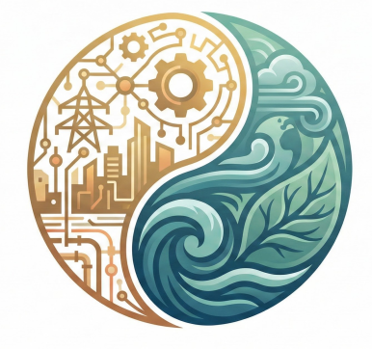

The Scenario Evolution Process
Objective: Update and adjust the Shared Socioeconomic Pathways (SSP) framework to fit the evolving needs of the scientific community
Timeframe: 4-year process – ready in 2030
Engagement opportunities:
Fill in survey to provide feedback on SSPs and input to the framework updates
Submit an academic paper to our special issue in Futures
Join the Working Group to increase diversity
Any ideas for funding workshops? Contact us
Check out the website for updated news and more information
https://sep.du.edu
sep@du.edu

