Slide 1
The Scenario Evolution Process
Evolving the Community Scenarios Framework

Slide 2
From SSPs to new updated Scenarios
Evolve community scenario framework:
  up-to-date and holistic: climate, nature, and development.
  solution-oriented, fit for research, assessments, and user-facing applications.
  analyse resilient equitable sustainable development, that reflects diverse perspectives.
We intend to do this in an inclusive and transparent way, initiated by ICONICS+ and executed through working groups ensuring diverse participation of researchers across regions, gender, career-stage, and disciplines.
SSP 5:
(Mit. Challenges Dominate)
Fossil-fueled
Development
SSP 3:
(High Challenges)
Regional Rivalry
Socio-economic
challenges for mitigation
SSP 2:
(Intermediate Challenges)
Middle of the Road
SSP 1:
(Low Challenges)
Sustainability
SSP 4:
(Adapt. Challenges Dominate)
Inequality
Socio-economic challenges
for adaptation
SSP narratives, quantitative elements: 2017 special issue of Global Environmental Change.
SSP Database, hosted by IIASA.

Slide 3

Timeline: the big picture
2026
2027
2028
2029
2030
2031
2032
2033
2034
2035
IPCC AR7
IPBES GA2
SDGs
IPCC AR8
CMIP7- ScenarioMIP
ISIMIP (impacts)
BES-SIM2
Bending the Curve2
CMIP8
IPBES Post-2030 Work Programme
Time window to evolve the framework

Slide 4
Overall timeline for SEP
1. Community input
2. Scenario framework design
3. Quantitative scenario design
Kick-off Webinar
Expert Workshop
Expert Workshop
1. Collect views,
proposals, ideas
2. Design and propose framework evolution.
Regional and global community review
3. Develop quantitative indicators and model implementations, both global and regional.
2026
2027
2028
2029
2030
Implementation depends on funding

Slide 5
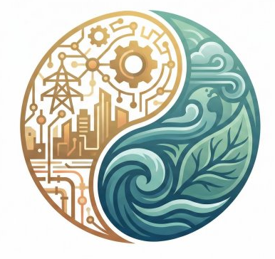
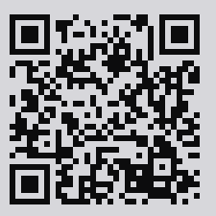
How can you engage?
SSP User Survey
Academic Paper Collection
Workshops & Conference Sessions
https://sep.du.edu
sep@du.edu
Community input ideas?
Help secure funding?
In-kind contributions through research?

